Slide 1
Whip Your Scripts into Shape: Optimizing PowerShell for Speed
Joshua King

Slide 2
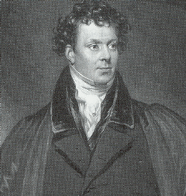
Who Am I?
Josh King
https://king.geek.nz
@WindosNZ

Slide 3
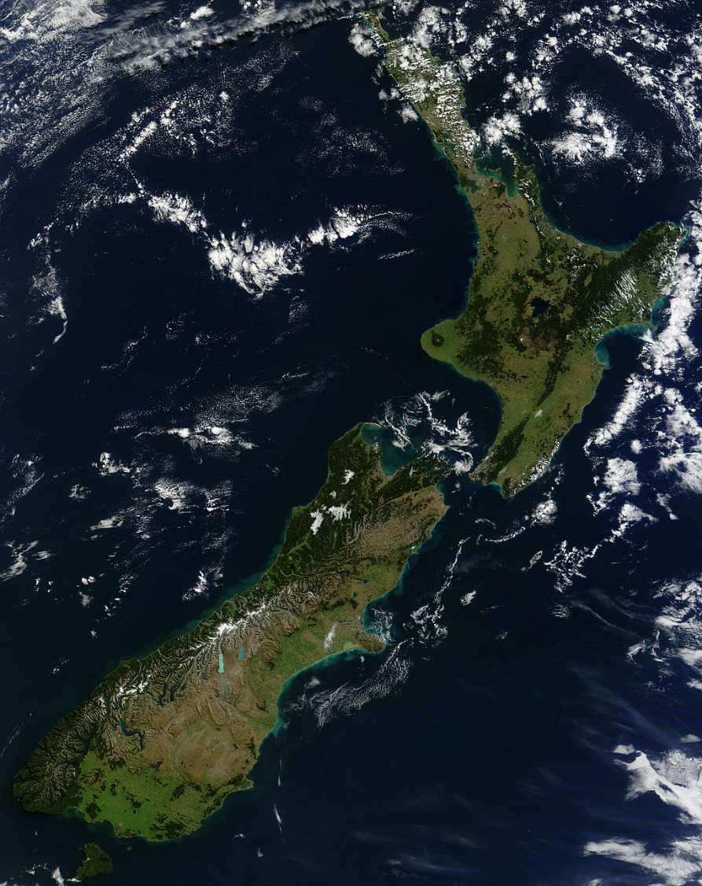




Credit: Tim Whittaker

Slide 4
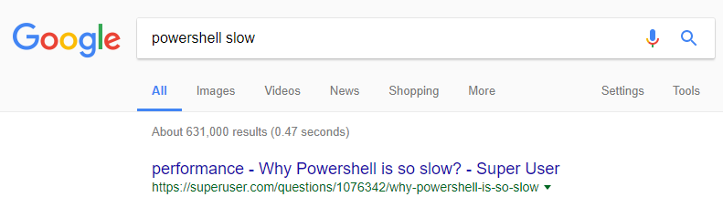
Speed & PowerShell
(Still a better love story than Twilight)
Bad perception, possibly thanks to start up times
Common complaint

Slide 5
A/B Testing
If you’re looking for improvements, measure it!
One change at a time
Test it more than once
Minimize the impact introduced by taking measurements
My tests will be handled by the “RunBucket” module:
Start-RunBucket -Control $Control -Variation $Variation -Title 'A/B Test'

Slide 6
About RunBucket
Uses PoshRSJob
Defaults to 100 iterations of each test case
Ignores both the slowest and fastest result
[Stopwatch]::StartNew() not Measure-Command
Results displayed via PowerShell Universal Dashboard

Slide 7
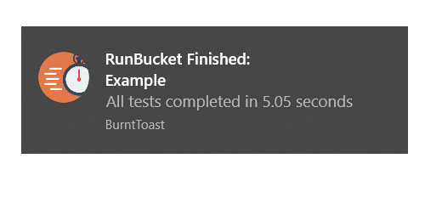
That’s Not Slack!
During demos, you’ll see toast notifications
These indicate that all test cases have finished
They are created via BurntToast

Slide 9
Are These Examples a Silver Bullet?
Memory consumption
CPU bottleneck
Breaking a working script
Your environment is a snowflake

Slide 10

Takeaways
Don’t Assume
Credit: AlphaPenguin

Slide 11
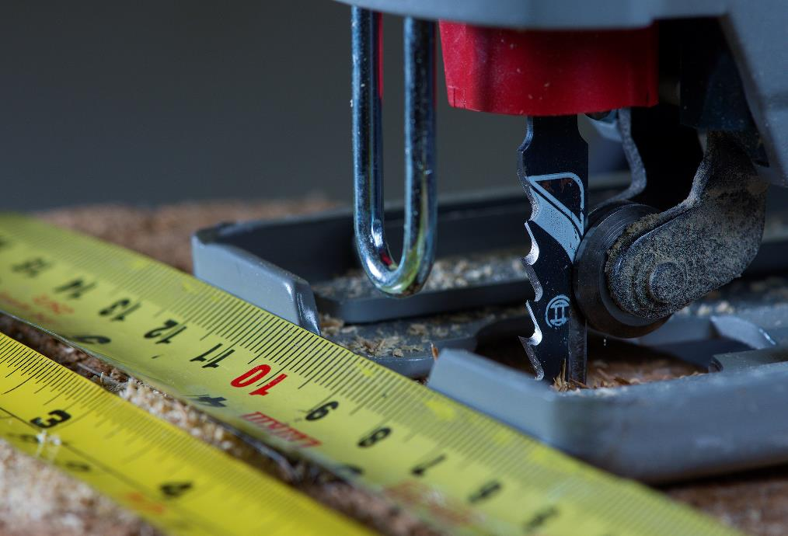
Takeaways
Don’t Assume
Measure twice
Credit: Rodger Evans

Slide 12

Takeaways
Don’t Assume
Measure twice
Revisit
Credit: Vinoth Chandar

Slide 13
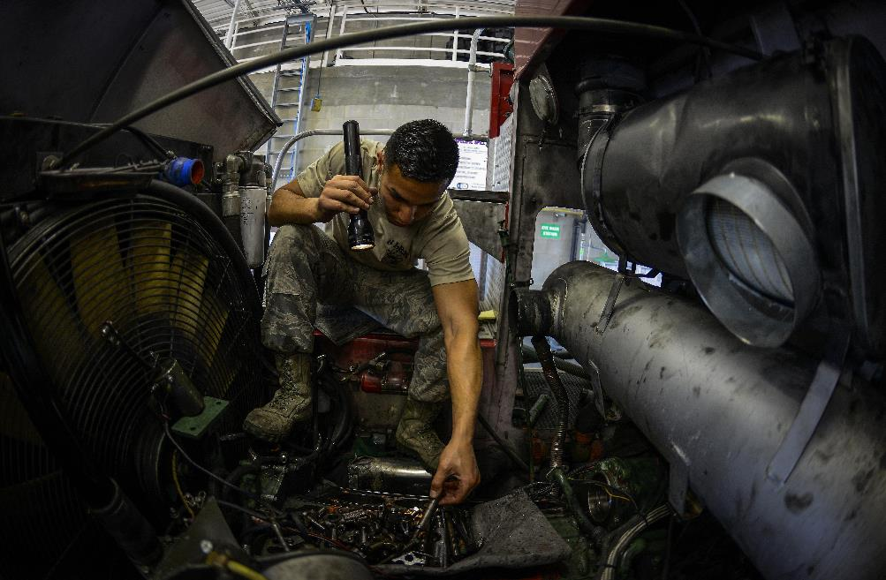
Takeaways
Don’t Assume
Measure twice
Revisit
Worry about optimisation after it’s working!
Credit: Senior Airman Melanie Bulow-Gonterman

Slide 14

Takeaways
Don’t Assume
Measure twice
Revisit
Worry about optimisation after it’s working!
Test your code!
Credit: Ade Russell

Slide 15
Get this slide deck and demo code from:
http://bit.ly/WindosPSH2018

